Slide 1
Cognitive states in flexible decision making
Rick Németh

Slide 2
The outline of the project
Data:
Parallel electrophysiological recordings from macaque MCC and LPFC
Extracted SUA
Goals:
Classify spikes (putative interneurons & pyramidal cells)
Characterize the layer-structure of the cortices
Create a state-space model for the SUA
Combine the results

Slide 3
The state-space model
Hidden Markov model with 6 states
Input:
10 min of SUA divided into bins of 2 ms
Each bin is labelled k  [1, …, n+1], where n is the number of single units
If only neuron k fires, the bin will be labelled k
If several neurons fire, a random label will be chosen out of the firing units
If no neuron fires the bin will be labelled n+1
The process:
Baum-Welch algorithm (parameter estimation)
Viterbi algorithm (state estimation)
Posterior probabilities
Introduction of null states

Slide 4
2 ms
Unit 1
Unit 2
Labels
1
1
1 or 2
3
1 or 2
3
2

Slide 5
2 ms
Unit 1
Unit 2
Labels
1
1
1 or 2
3
1 or 2
3
2
States
1
1
2
2
3
1
3

Slide 6
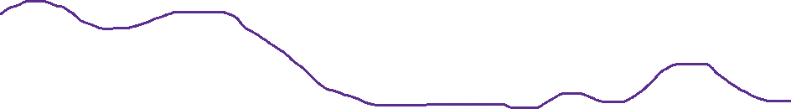
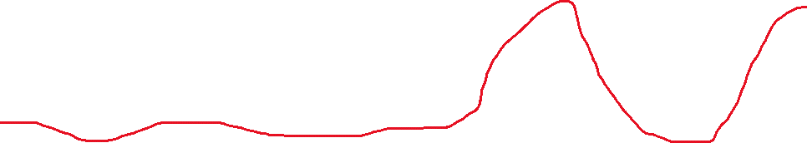
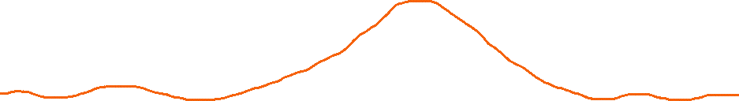
2 ms
Posterior probabilities
Unit 1
Unit 2
State duration of 4 ms

Slide 7
2 ms
Unit 1
Unit 2
Null state
Threshold (0.8)

Slide 8
2 ms
Unit 1
Unit 2
Null state

Slide 9
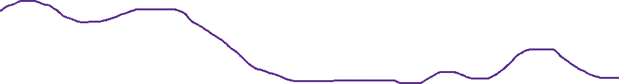

Unit 1
Unit 2
Unit 1
Unit 2

Slide 10
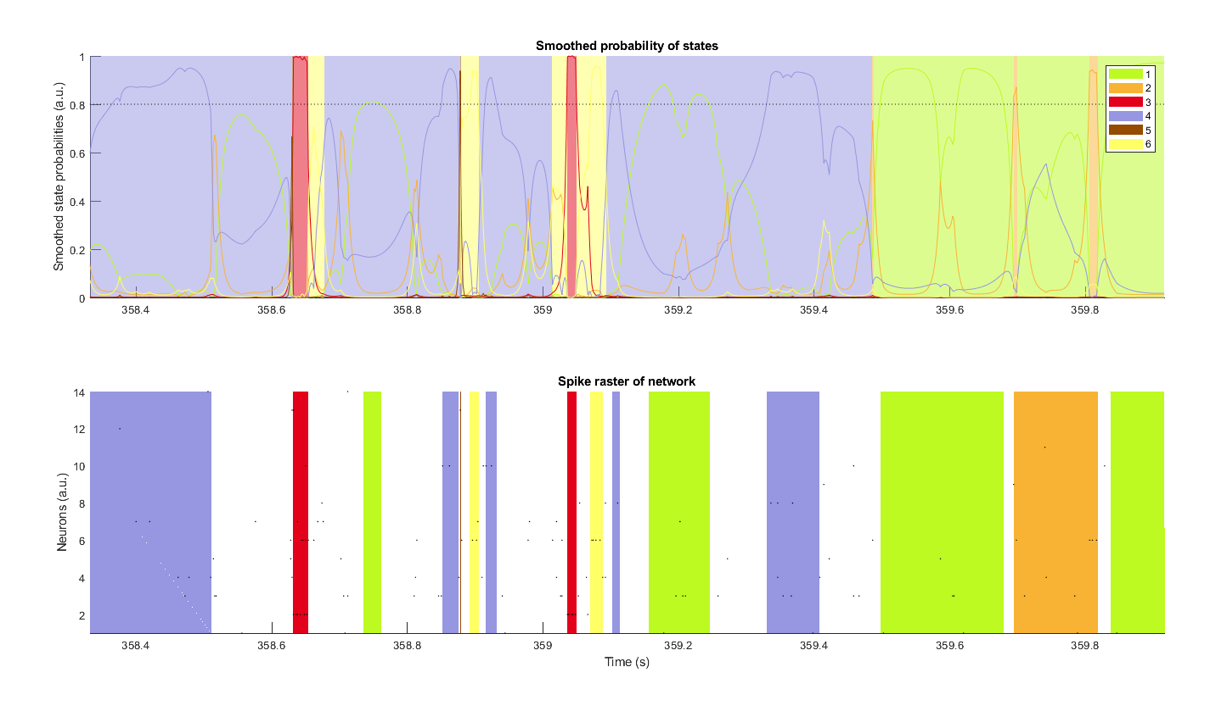
States and posterior probabilities
States with null states introduced

Slide 11
Current goal

Slide 12
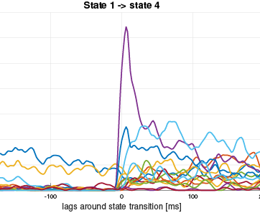
Connection between units and states
Aligning spikes with transitions
PSTH: spike density vs lags
Question: where to center it?
End of states in general?
End of a given state, beginning of a next state?
Null or no null?

Slide 13
Results (so far)

Slide 14
Statistics
LPFC and MCC duration are from different distributions (K-S test, p ≈ 0)
Shorter states (and more switches) in MCC (Wilcox-test, p ≈ 0)
No recognizable spatial organization

Slide 15

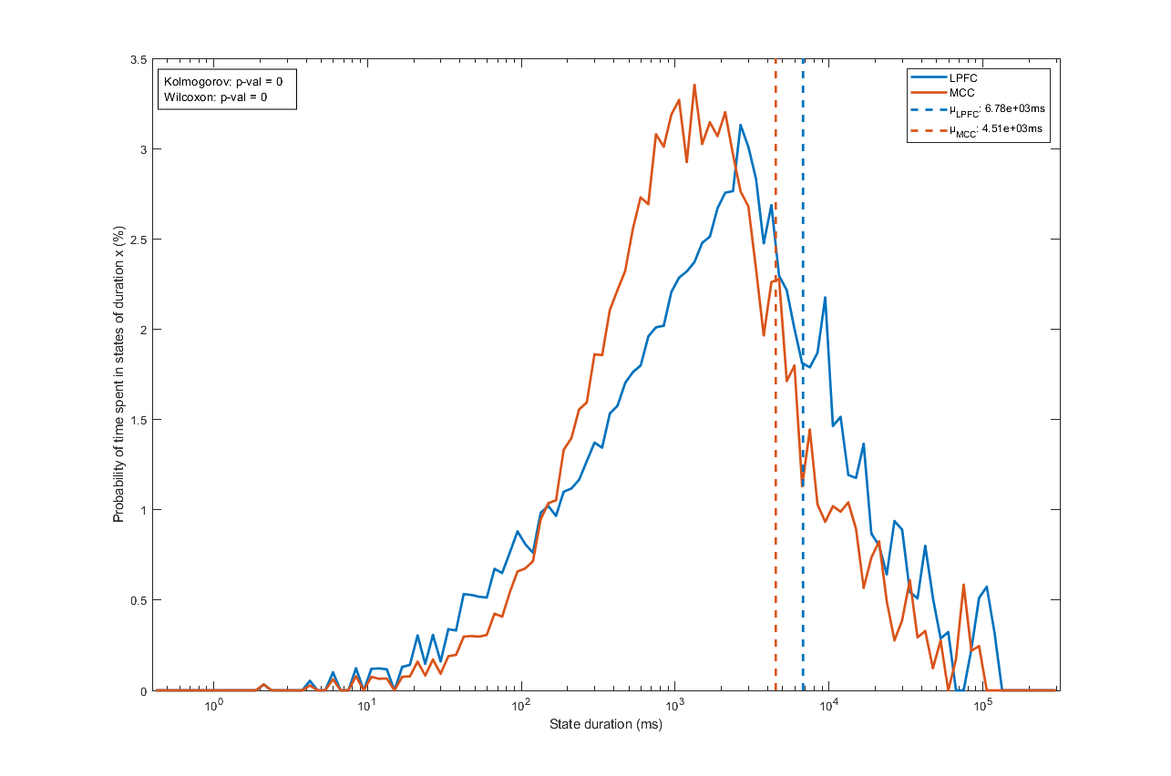
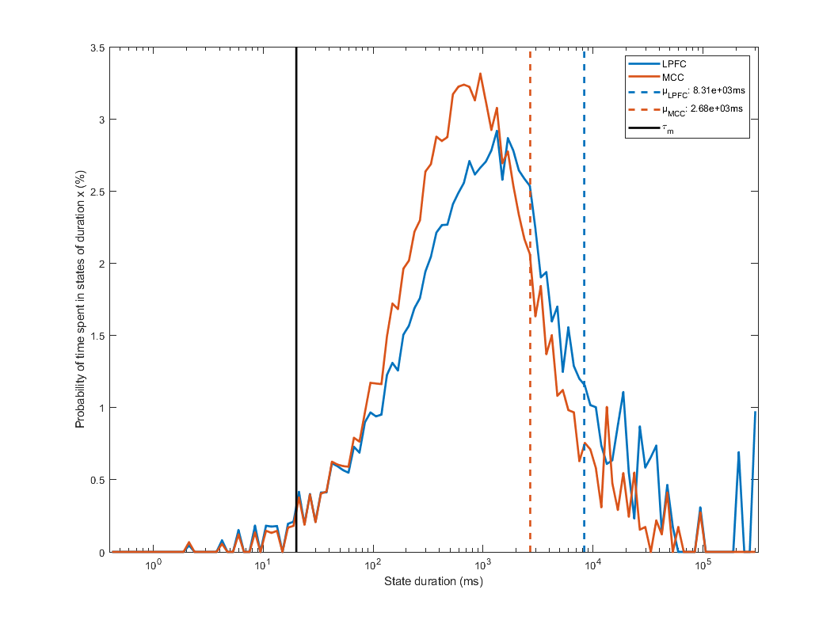
Duration distribution
No null state
With null state

Slide 16
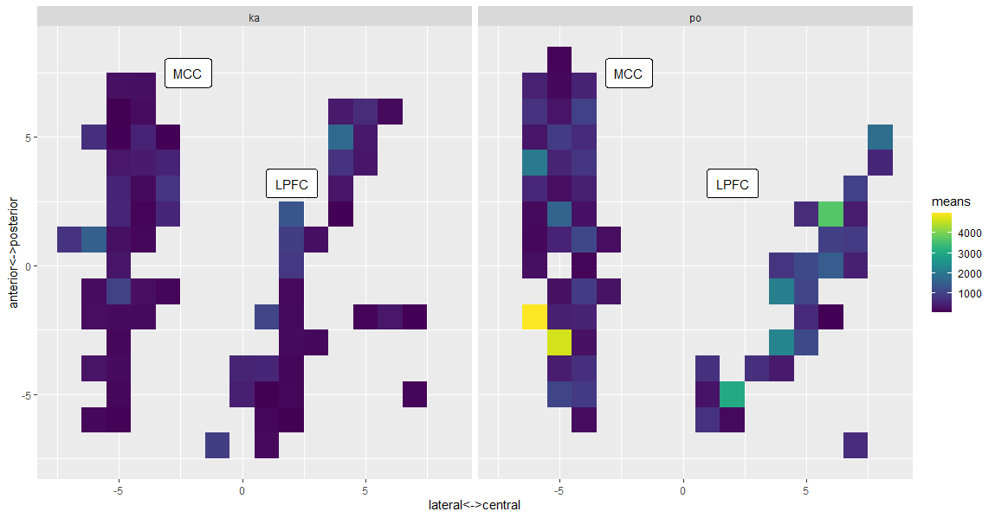
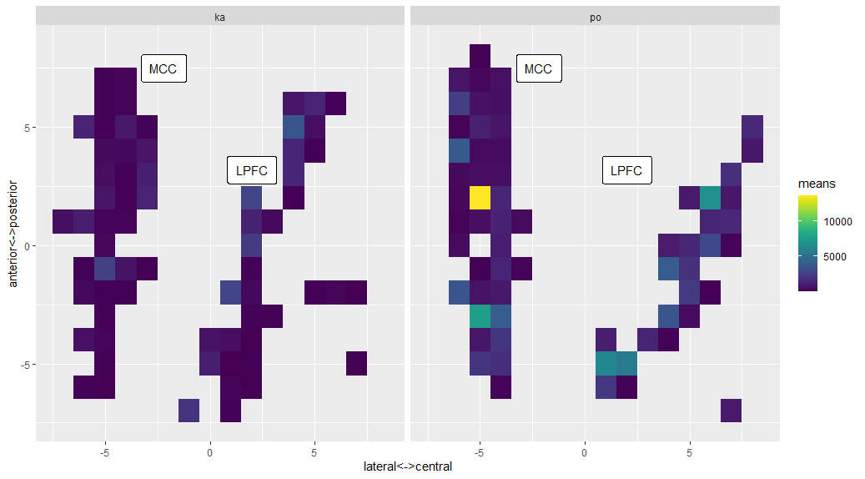
Mean state duration spatial distribution
No null state
With null state

Slide 17
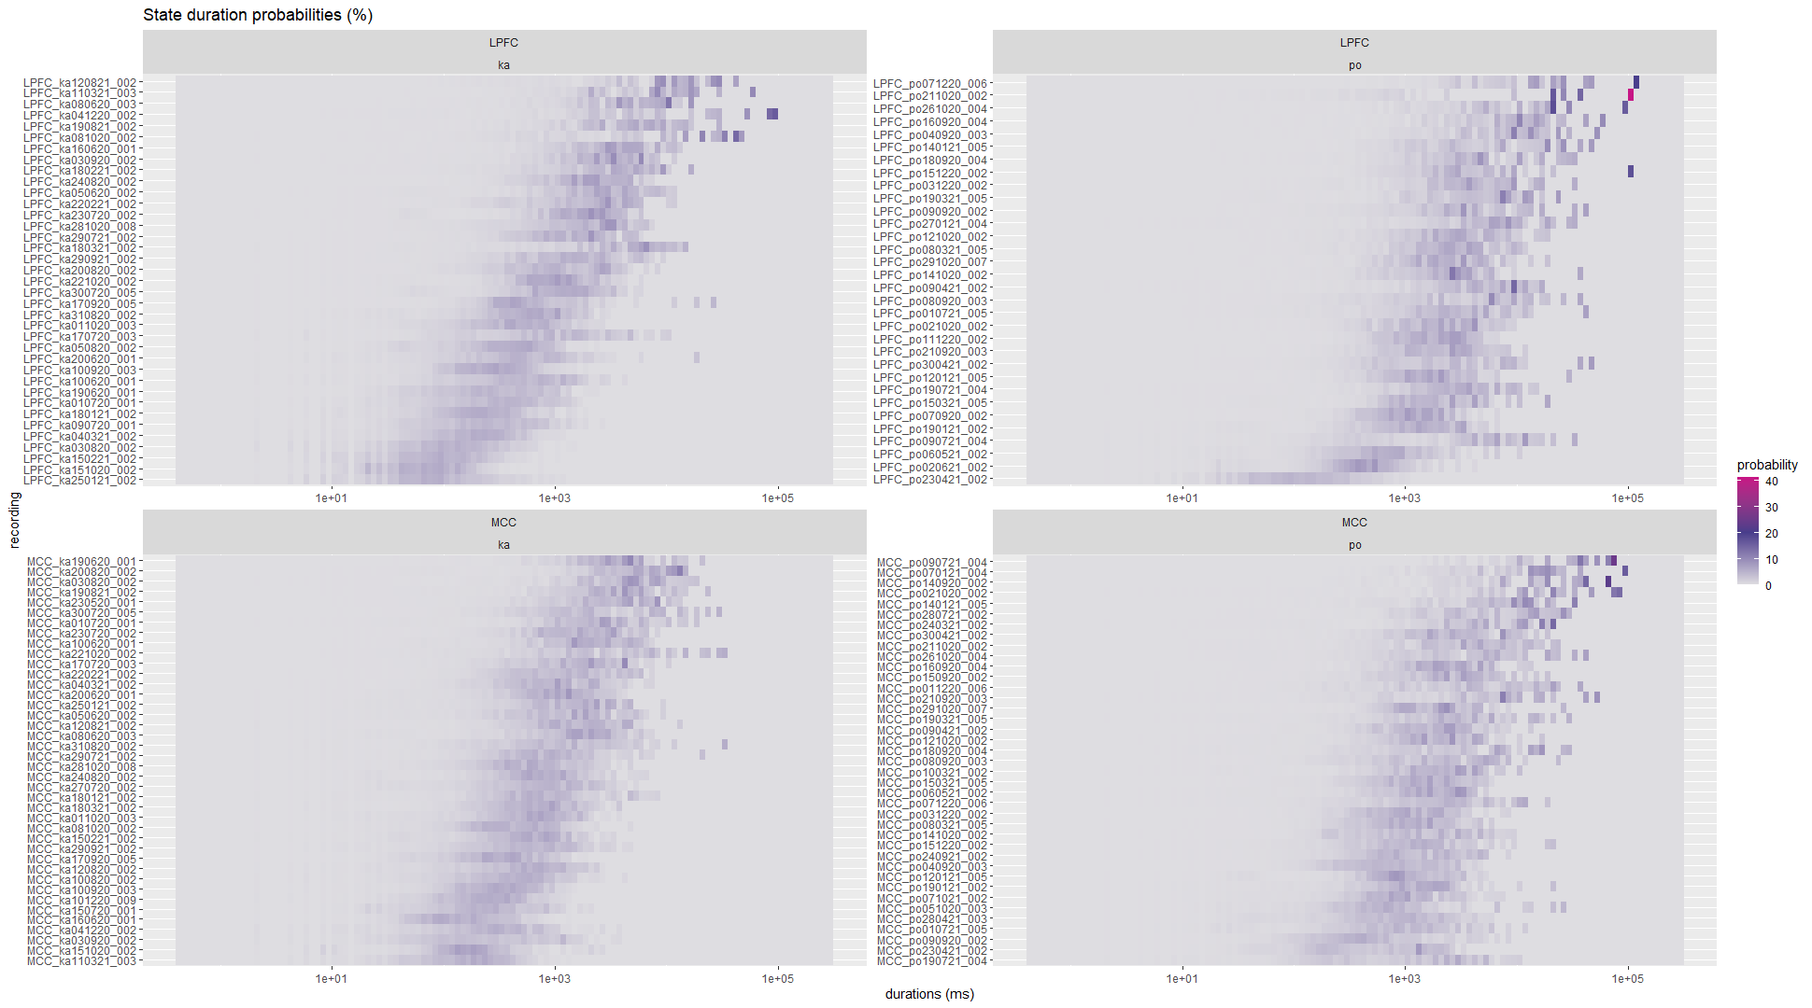

Slide 18
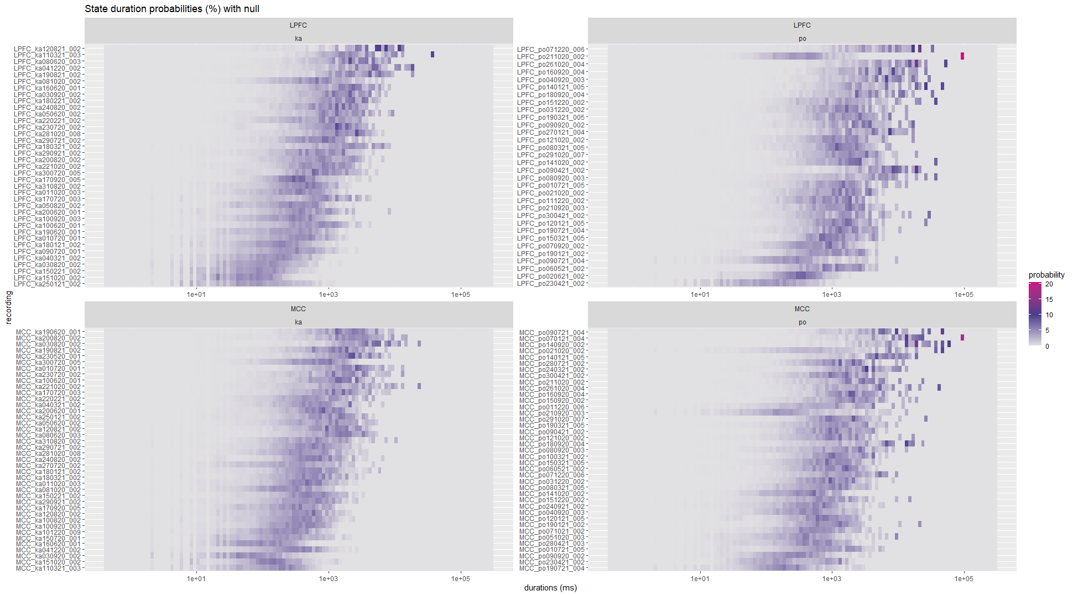

Slide 19
Algorithmic considerations

Slide 20
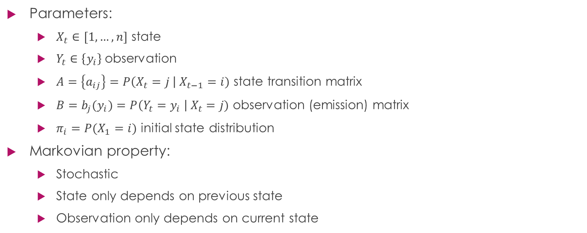
HMM
Parameters:
$X_{t}∈[1, …, n]$ state
$Y_{t}∈\left\{y_{i}\right\}$observation
$A=\left\{a_{ij}\right\}=P\left(X_{t}=j \right| X_{t−1}=i)$ state transition matrix
$B=b_{j}(y_{i})=P\left(Y_{t}=y_{i} \right| X_{t}=j)$ observation (emission) matrix
$π_{i}=P(X_{1}=i)$ initial state distribution
Markovian property:
Stochastic
State only depends on previous state
Observation only depends on current state

Slide 21
0.3
0.7
0.3
0.7
0.6
0.4
0.6
0.4
0.1
0.3
0.7
0.9
0.7
0.3
0.1
0.9

Slide 22
Forward-backward probabilities

Slide 23
0.7
0.3
0.5
0
1
A =
0.7
0.3
B =
π =
Y =
0.4
0.6
0.1
0.9
0.5
1
0
θ

Slide 24
0.7
0.3
0.5
0
1
A =
0.7
0.3
B =
π =
Y =
0.4
0.6
0.1
0.9
0.5
1
0
θ
Day 0
0.5
0.5

Slide 25
0.7
0.3
0.5
0
1
A =
0.7
0.3
B =
π =
Y =
0.4
0.6
0.1
0.9
0.5
1
0
θ
0.7
0.3
0.7
0.3
Day 0
Day 1
0.4
0.6
0.1
0.9
0.5
0.055
0.55
0.45
×
0.9
=
0.5
0.5
0
1
0.1
0.5
0.405

Slide 26
0.7
0.3
0.5
0
1
A =
0.7
0.3
B =
π =
Y =
0.4
0.6
0.1
0.9
0.5
1
0
θ
Day 0
Day 1
Day 2
0.5
0.055
0.12
0.305
0.64
→
→
0.5
0.405
0.88
0.169
0.36

Slide 27
The Baum-Welch algorithm

Slide 28
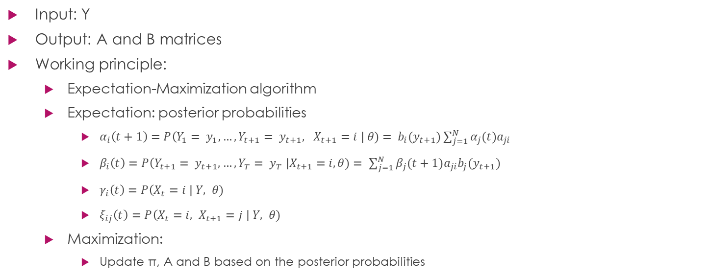
Baum-Welch algorithm
Input: Y
Output: A and B matrices
Working principle:
Expectation-Maximization algorithm
Expectation: posterior probabilities
$α_{i}\left(t+1\right)=P\left(Y_{1}= y_{1}, …, Y_{t+1}= y_{t+1}, X_{t+1}=i \right| θ)= b_{i}(y_{t+1})\sum_{j=1}^{N}{α_{j}(t)a_{ji}}$
$β_{i}\left(t\right)=P\left(Y_{t+1}= y_{t+1}, …, Y_{T}= y_{T} \right|X_{t+1}=i, θ)= \sum_{j=1}^{N}{β_{j}(t+1)a_{ji}b_{j}(y_{t+1})}$
$γ_{i}\left(t\right)=P\left(X_{t}=i \right| Y, θ)$
$ξ_{ij}\left(t\right)=P\left(X_{t}=i, X_{t+1}=j \right| Y, θ)$
Maximization:
Update π, A and B based on the posterior probabilities

Slide 29
The Viterbi algorithm

Slide 30
The Viterbi algorithm
Input: Y, A and B matrices, π
Output: X
Properties:
State space-based search
Mathematically optimal
Working principle:
Considers (and stores) the whole path in the state-space → optimal sequence
Only calculates most possible states for each timepoint

Slide 31
0.7
0.3
0.5
0
1
A =
0.7
0.3
B =
π =
Y =
0.4
0.6
0.1
0.9
0.5
1
0
θ
Day 0
0.5
0.5

Slide 32
0.7
0.3
0.5
0
1
A =
0.7
0.3
B =
π =
Y =
0.4
0.6
0.1
0.9
0.5
1
0
θ
Day 0
Day 1
0.5×0.7×0.1
0.5
?
0.5
?
0.5×0.4×0.1

Slide 33
0.7
0.3
0.5
0
1
A =
0.7
0.3
B =
π =
Y =
0.4
0.6
0.1
0.9
0.5
1
0
θ
Day 0
Day 1
0.035
0.5
?
0.5×0.3×0.9
0.5
?
0.5×0.6×0.9

Slide 34
0.7
0.3
0.5
0
1
A =
0.7
0.3
B =
π =
Y =
0.4
0.6
0.1
0.9
0.5
1
0
θ
Day 0
Day 1
0.035
0.5
0.11
0.5
0.89
0.27

Slide 35
0.7
0.3
0.5
0
1
A =
0.7
0.3
B =
π =
Y =
0.4
0.6
0.1
0.9
0.5
1
0
θ
Day 0
Day 1
Day 2
0.11×0.7×0.7
0.5
0.11
?
0.5
0.89
?
0.89×0.4×0.7

Slide 36
0.7
0.3
0.5
0
1
A =
0.7
0.3
B =
π =
Y =
0.4
0.6
0.1
0.9
0.5
1
0
θ
Day 0
Day 1
Day 2
0.11×0.3×0.3
0.5
0.11
0.249
?
0.5
0.89
?
0.89×0.6×0.3

Slide 37
0.7
0.3
0.5
0
1
A =
0.7
0.3
B =
π =
Y =
0.4
0.6
0.1
0.9
0.5
1
0
θ
Day 0
Day 1
Day 2
0.5
0.11
0.61
0.249
0.5
0.89
0.39
0.16

Slide 38
0.7
0.3
0.5
0
1
A =
0.7
0.3
B =
π =
Y =
0.4
0.6
0.1
0.9
0.5
1
0
θ
×
×
Day 2
Day 0
Day 1
0.5
0.11
0.61
0.5
0.89
0.39

Slide 39
Day 0
Day 1
Day 2
0.5
0.12
0.64
0.5
0.88
0.36
×
×
Day 2
Day 0
Day 1
0.5
0.11
0.61
0.5
0.89
0.39

Slide 40
The two methods
With null
W/O null
Given Y
Baum-Welch: computes A, B and π
Uses forward-backward probabilities
Forward-backward algorithm:
Computes posterior probabilities
Thresholding: results in X
Null states are included
Given Y
Baum-Welch: computes A, B and π
Uses forward-backward probabilities
Viterbi-algorithm: computes X
Mathematically optimal

Slide 41
States and posterior probabilities
States with null states introduced

